Slide 1


YUVRAJ SINGH (20240110300291, CSE-AI D)
SUDHANSHU KUMAR (202401100300253, CSE-AI D)
VIVEK KUMAR (202401100300282, CSE-AI D)
YUVRAJ PATEL (202401100300290, CSE-AI D)
SHANI KUMAR (202401100300224, CSE-AI D)

Slide 2


EMPLOYEE ATTRITION PREDICTION
Develop a machine learning model to predict if an employee is likely to leave the
company using IBM HR Analytics data. Focus on classification techniques and visualize feature
importance.

Slide 3

INTRODUCTION
Employee attrition—when employees leave a company—is a major concern for businesses, as it leads to increased recruitment costs, loss of talent, and reduced productivity.
To address this issue, we aim to develop a machine learning model that can predict whether an employee is likely to leave the company, using the IBM HR Analytics Employee Attrition dataset.
This project uses classification techniques to analyze employee data and identify the key factors contributing to attrition. By understanding which features (such as job satisfaction, work-life balance, salary, etc.) are most important, organizations can take proactive steps to retain valuable employees.

Slide 4

METHODOLOGY
1. Data Acquisition
from google.colab import files
uploaded = files.upload()
df=pd.read_csv('WA_Fn-UseC_-HR-Employee-Attrition.csv')
Purpose: Load the HR dataset containing employee records and their attrition status (Yes/No).

Slide 5
METHODOLOGY
.
🧹 2. Data Preprocessing
a. Encode target variable:
df['Attrition'] = le.fit_transform(df['Attrition'])
Purpose: Convert the target Attrition from categorical (Yes/No) to numeric (1/0) for model training.
b. Drop non-informative columns:
df.drop(['EmployeeNumber', 'EmployeeCount', 'Over18', 'StandardHours'], axis=1, inplace=True)
Purpose: Remove features that don't help in prediction (e.g., ID columns, constants).
c. Encode categorical features:
df[categorical_cols] = df[categorical_cols].apply(le.fit_transform)
Purpose: Convert remaining categorical columns into numeric values using Label Encoding.

Slide 6
METHODOLOGY
3. Feature Engineering and Scaling
X = df.drop('Attrition', axis=1)
y = df['Attrition']
scaler = StandardScaler()
X_scaled = scaler.fit_transform(X)
Purpose:
Separate features (X) from target (y).
Normalize features to have zero mean and unit variance—this helps logistic regression converge better.

Slide 7
METHODOLOGY
4. Train/Test Split
X_train, X_test, y_train, y_test = train_test_split(...)
Purpose: Split the dataset into training and testing sets to evaluate generalization on unseen data. Stratified split maintains class balance.

Slide 8
METHODOLOGY
5. MODEL TRAINING (LOGISTIC REGRESSION)
MODEL = LOGISTICREGRESSION(...).FIT(X_TRAIN, Y_TRAIN)
PURPOSE: EVALUATE PERFORMANCE USING METRICS LIKE PRECISION, RECALL, AND F1-SCORE.

Slide 9
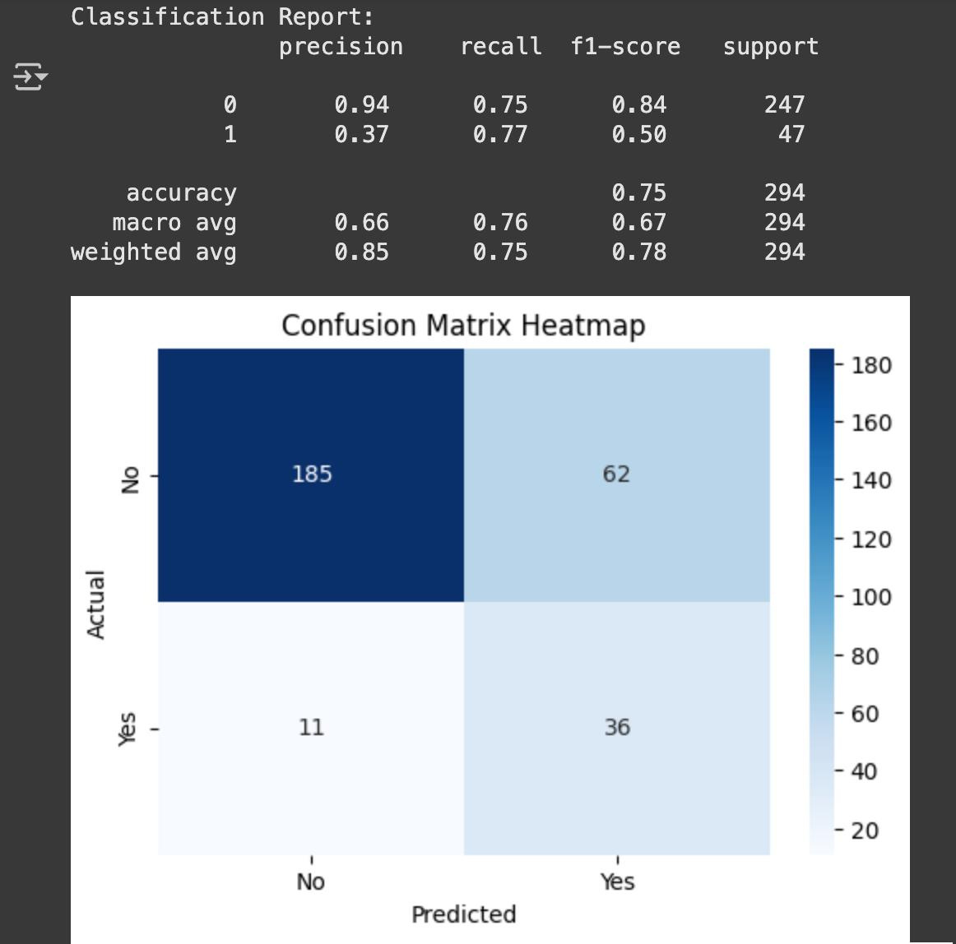
OUTPUT

Slide 10
REFERENCES
• IBM HR ANALYTICS EMPLOYEE ATTRITION DATASET (KAGGLE): HTTPS://WWW.KAGGLE.COM/DATASETS/PAVANSUBHASHT/IBM-HR-ANALYTICS-ATTRITION-DATASET
• SCIKIT-LEARN DOCUMENTATION:
HTTPS://SCIKIT-LEARN.ORG
• PANDAS DOCUMENTATION:
HTTPS://PANDAS.PYDATA.ORG
• SEABORN VISUALIZATION LIBRARY: HTTPS://SEABORN.PYDATA.ORG
• RESEARCH ARTICLES ON EMPLOYEE RETENTION AND HR ANALYTICS

Slide 11
THANK YOU!

